Slide 1
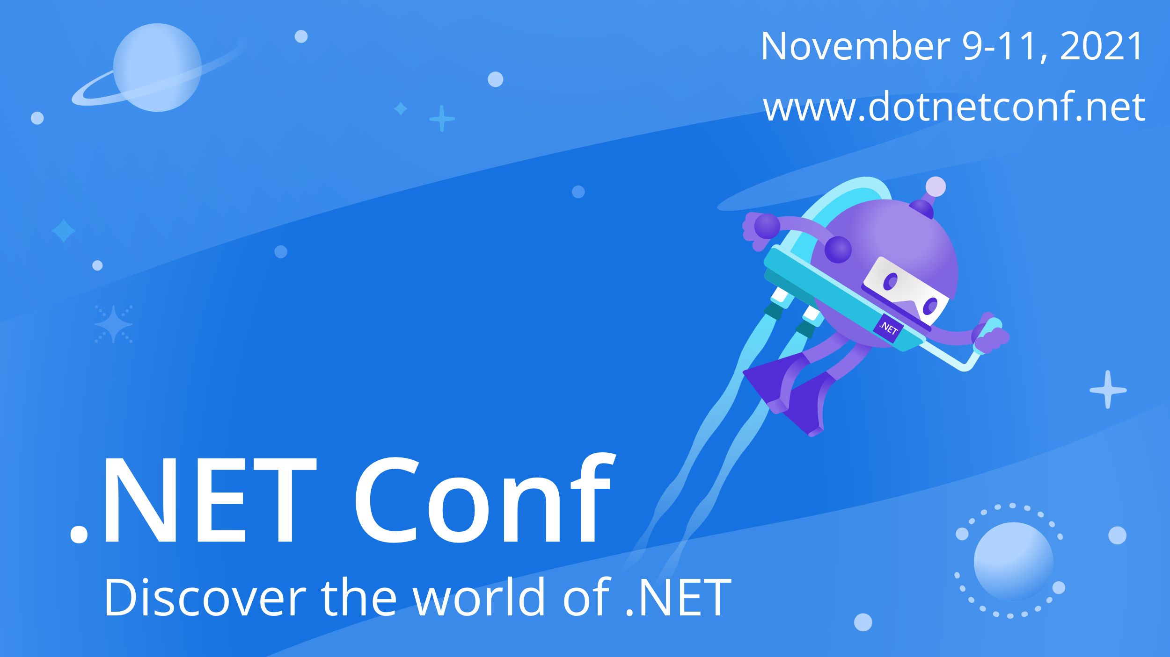

Slide 2


.NET Internet of Things
Melissa Houghton
melissahoughton.dev
melissahoughton
melissahoughton
meliss_houghton

Slide 3




About Me
Lead Software Engineer
Developer Technologies
melissahoughton.dev
melissahoughton
melissahoughton
meliss_houghton

Slide 4
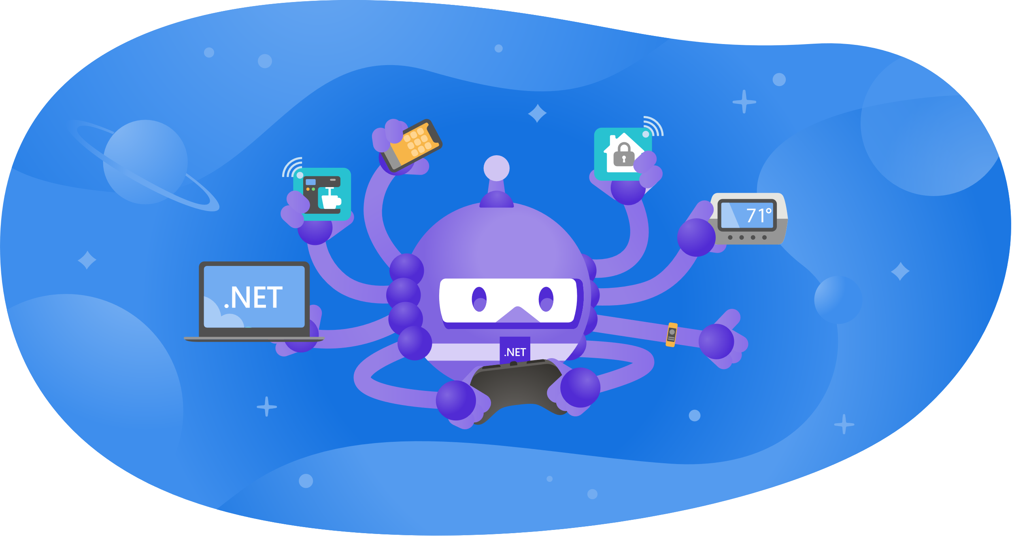
What is IoT?

Slide 5

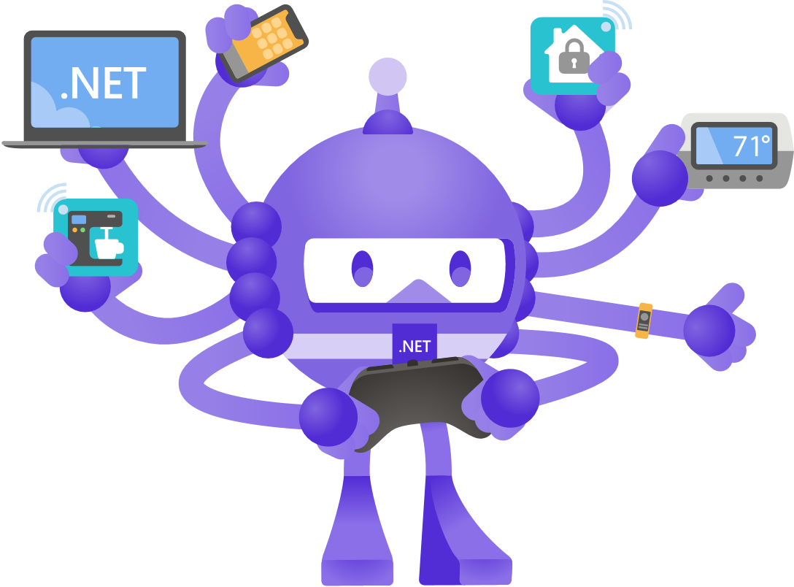

How can you use .NET for IoT

Slide 6
.NET IoT Libraries
Libraries
Device Bindings
Tooling
CLI
Docker
Templates
Testing
Analog Converters
Digital Logic
Display Controller
I/O Expanders
Sensors
LED Drivers
Memory
Motor Drivers
Real Time Clocks
Core APIs
ADC
CAN
GPIO
I2C
PWM
SPI
Futures
System.Device.Gpio
System.Device.*
Platform
X86
X64
ARM32
ARM64
Windows 10 IoT / Linux
Hardware
Raspberry Pi
HummingBoard
BeagleBone Black
Custom Hardware
Maker Boards

Slide 7
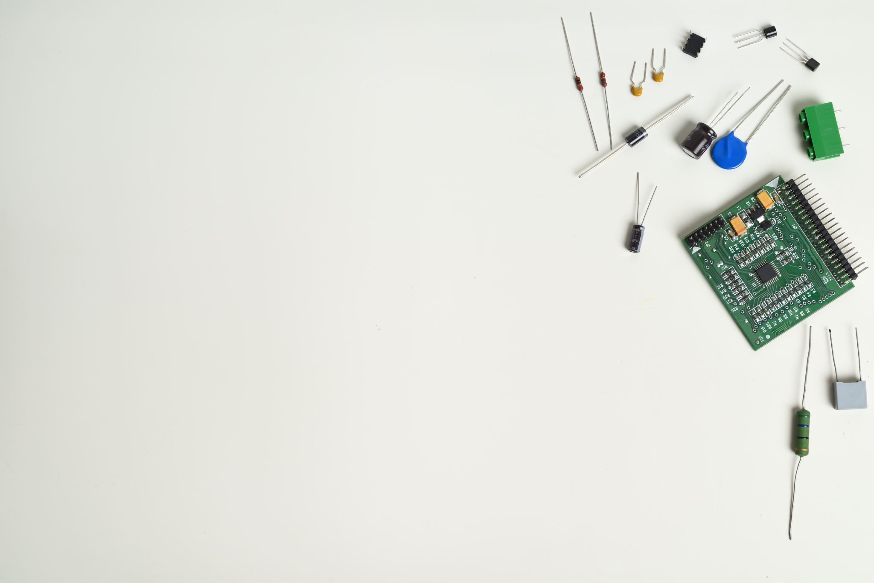
System.Device.Gpio
Protocols Including:
General-purpose I/O (GPIO)
Inter-Integrated Circuit (I2C)
Serial Peripheral Interface (SPI)
Pulse Width Modulation (PWM)
Serial port

Slide 8

Iot.Device.Bindings
https://github.com/dotnet/iot/tree/main/src/devices

Slide 9

Demo

Slide 10
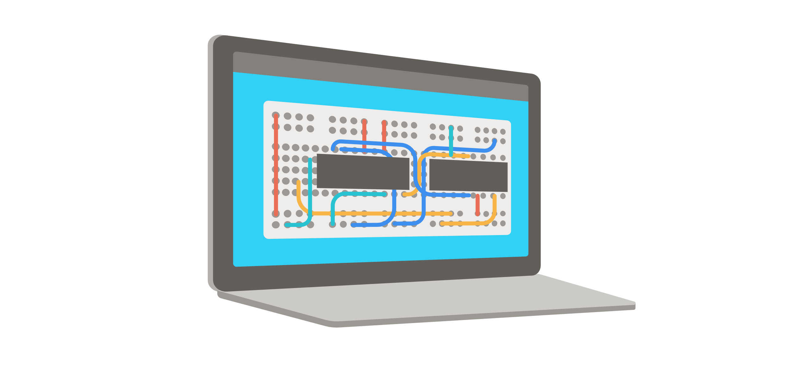
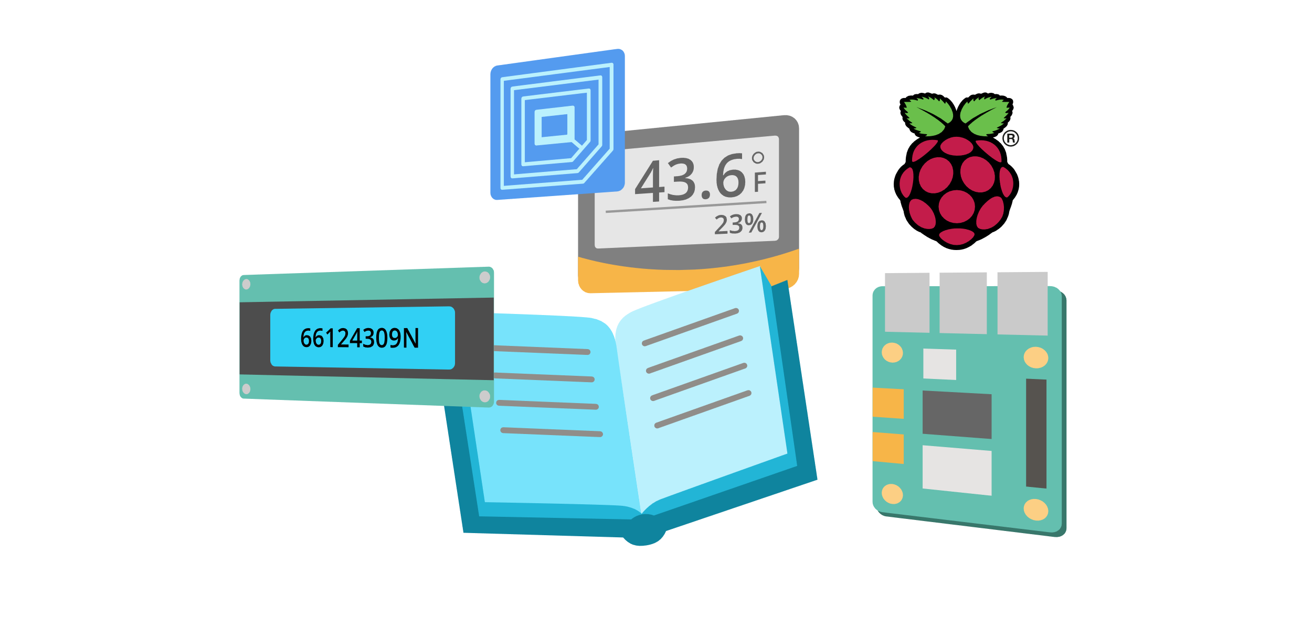

Tools

Slide 11

Deployment

Slide 12
Framework-dependent
# Install .NET on the device
curl -sSL https://dot.net/v1/dotnet-install.sh | bash /dev/stdin --channel Current
# Publish the app with Deployment mode = Framework-dependent and Target runtime = Portable
dotnet publish
# Copy the files from the computer to the device
scp -r /publish-location/* pi@raspberrypi:/home/pi/deployment-location/
# Run the app on the device
dotnet HelloWorld.dll
Self-contained
# Publish the app with Deployment mode = Self-contained and Target runtime = linux-arm
dotnet publish -r linux-arm
# Copy the files from the computer to the device
scp -r /publish-location/* pi@raspberrypi:/home/pi/deployment-location/
# Run the app on the device
chmod +x HelloWorld
./HelloWorld

Slide 13
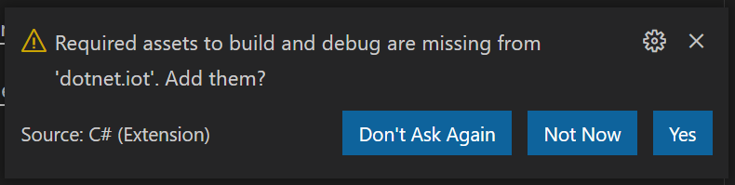
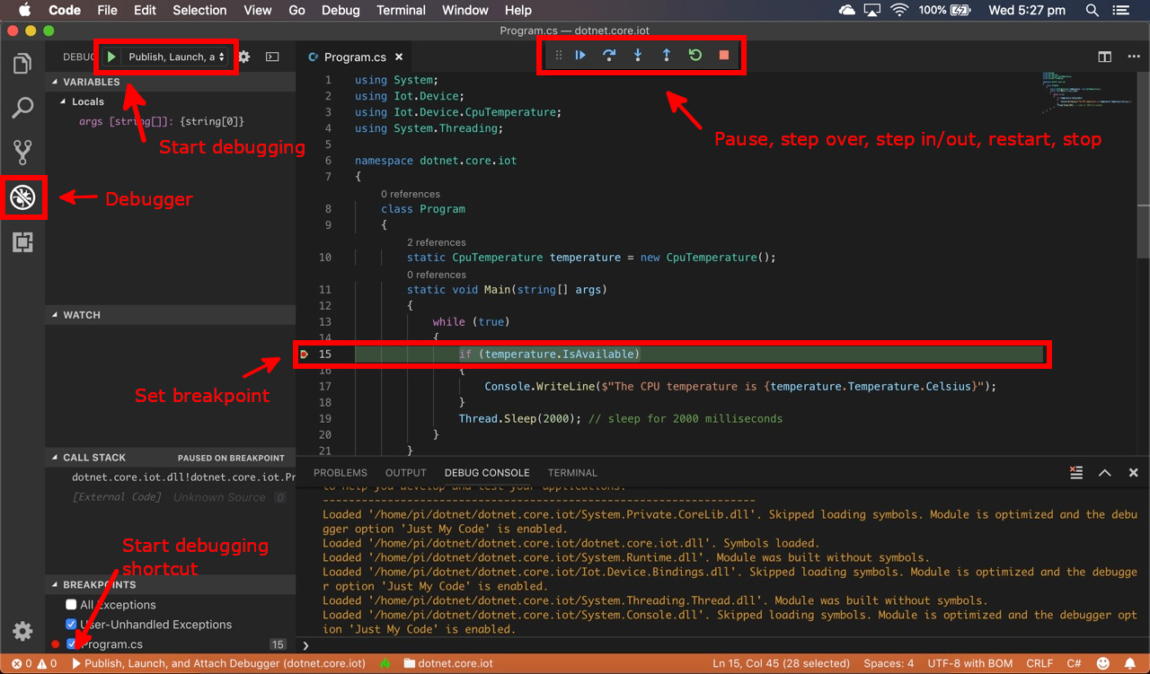

Debugging

Slide 14

Demo

Slide 15

.NET nanoFramework

Slide 16

Demo

Slide 17
.NET IoT
nanoFramework
Powerful boards
All .NET core libraries
Iot.Device.Bindings and System.Device.Gpio
Manual deployment setup
Manual remote debugging
Deploy the code via SSH connection
Low-level microcontrollers
Specific .NET libraries
Specific packages per sensor
Built-in deployment
Remote debugging experience
Deploy via wired connection

Slide 18

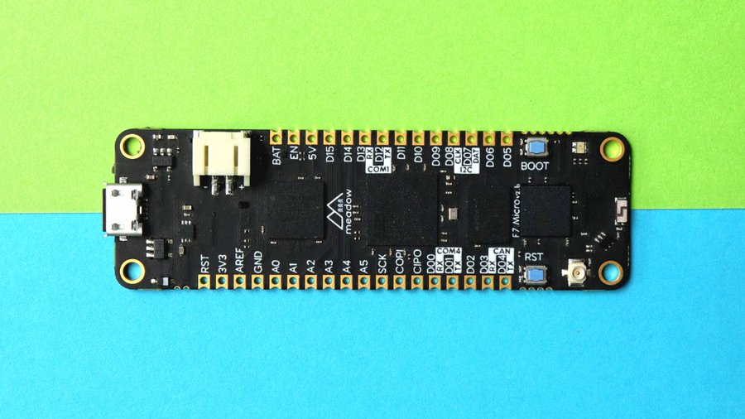

Meadow

Slide 19

Why use Meadow
Enterprise IoT
Full .NET on embeddable microcontrollers
Plug and Play IoT Library
Focused on Security
Cloud agnostic

Slide 20
using Meadow;
using System.Threading;
namespace HelloMeadow
{
class Program
{
static IApp app;
public static void Main(string[] args)
{
// instantiate & run new meadow app
app = new MeadowApp();
Thread.Sleep(Timeout.Infinite);
}
}
}
using Meadow;
using Meadow.Devices;
using Meadow.Foundation.Leds;
namespace HelloMeadow
{
public class MeadowApp : App<F7Micro, MeadowApp>
{
public MeadowApp()
{
var pwmLed = new PwmLed(
Device, Device.Pins.D13, TypicalForwardVoltage.Blue);
// pulse the LED
pwmLed.StartPulse();
}
}
}
Program.cs
MeadowApp.cs

Slide 21

Azure IoT SDK for .NET
https://github.com/Azure/azure-iot-sdk-csharp

Slide 22

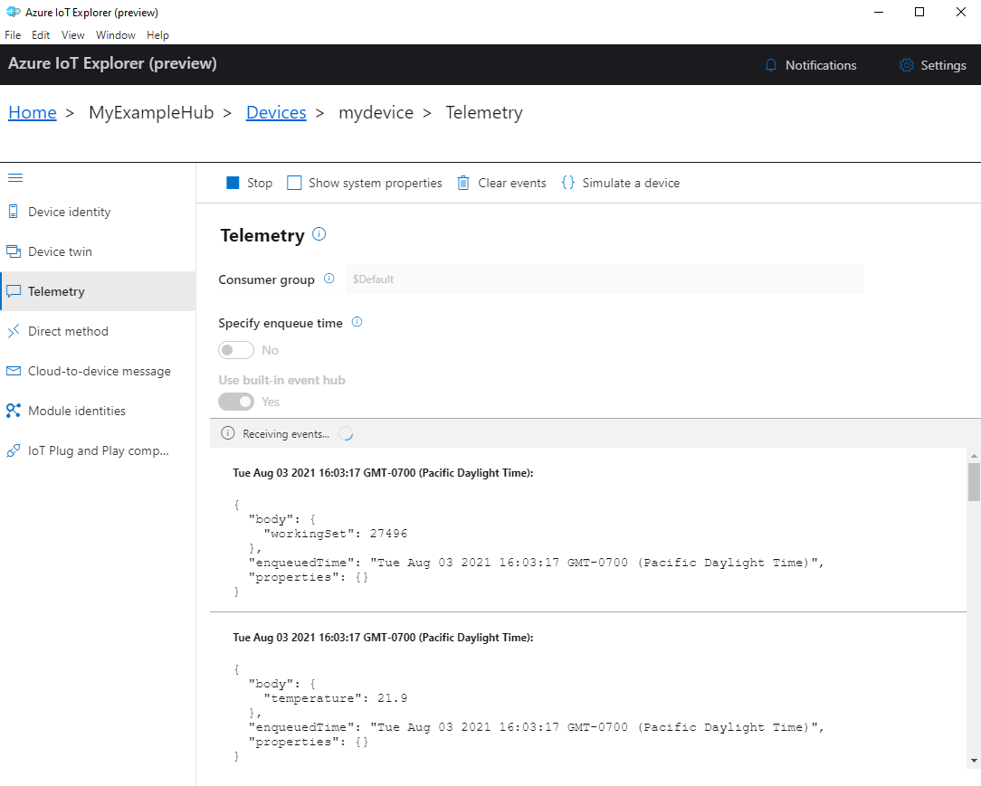
Azure IoT Hub
// Create device client
// And connect to IoT Hub using MQTT protocol
DeviceClient deviceClient = DeviceClient.Create(
iotHubHostName,
deviceAuthentication, TransportType.Mqtt); ...
// Send the telemetry message.
await deviceClient.SendEventAsync(message);

Slide 23
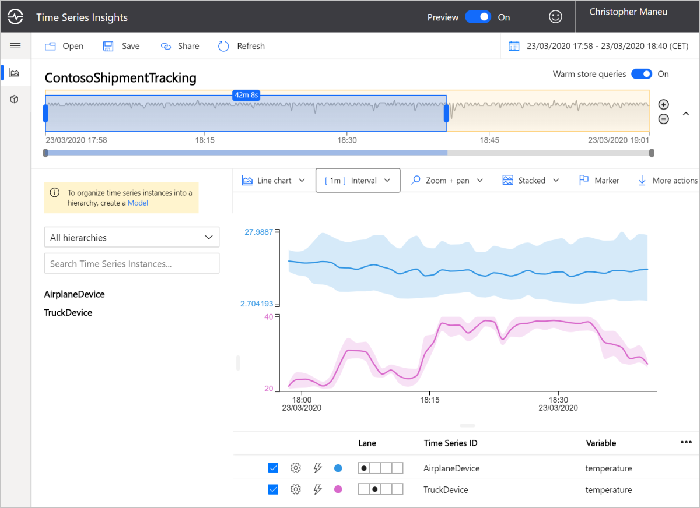
Time Series Insights

Slide 24
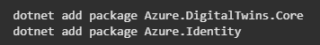
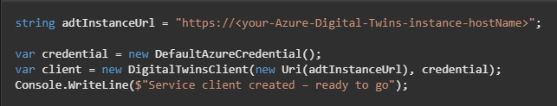
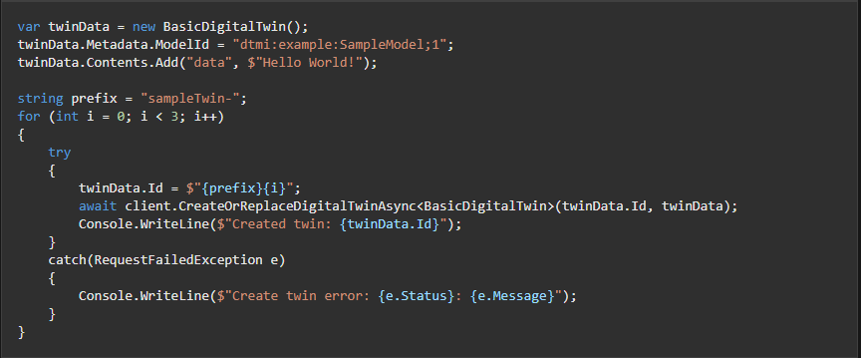
Digital Twins

Slide 25
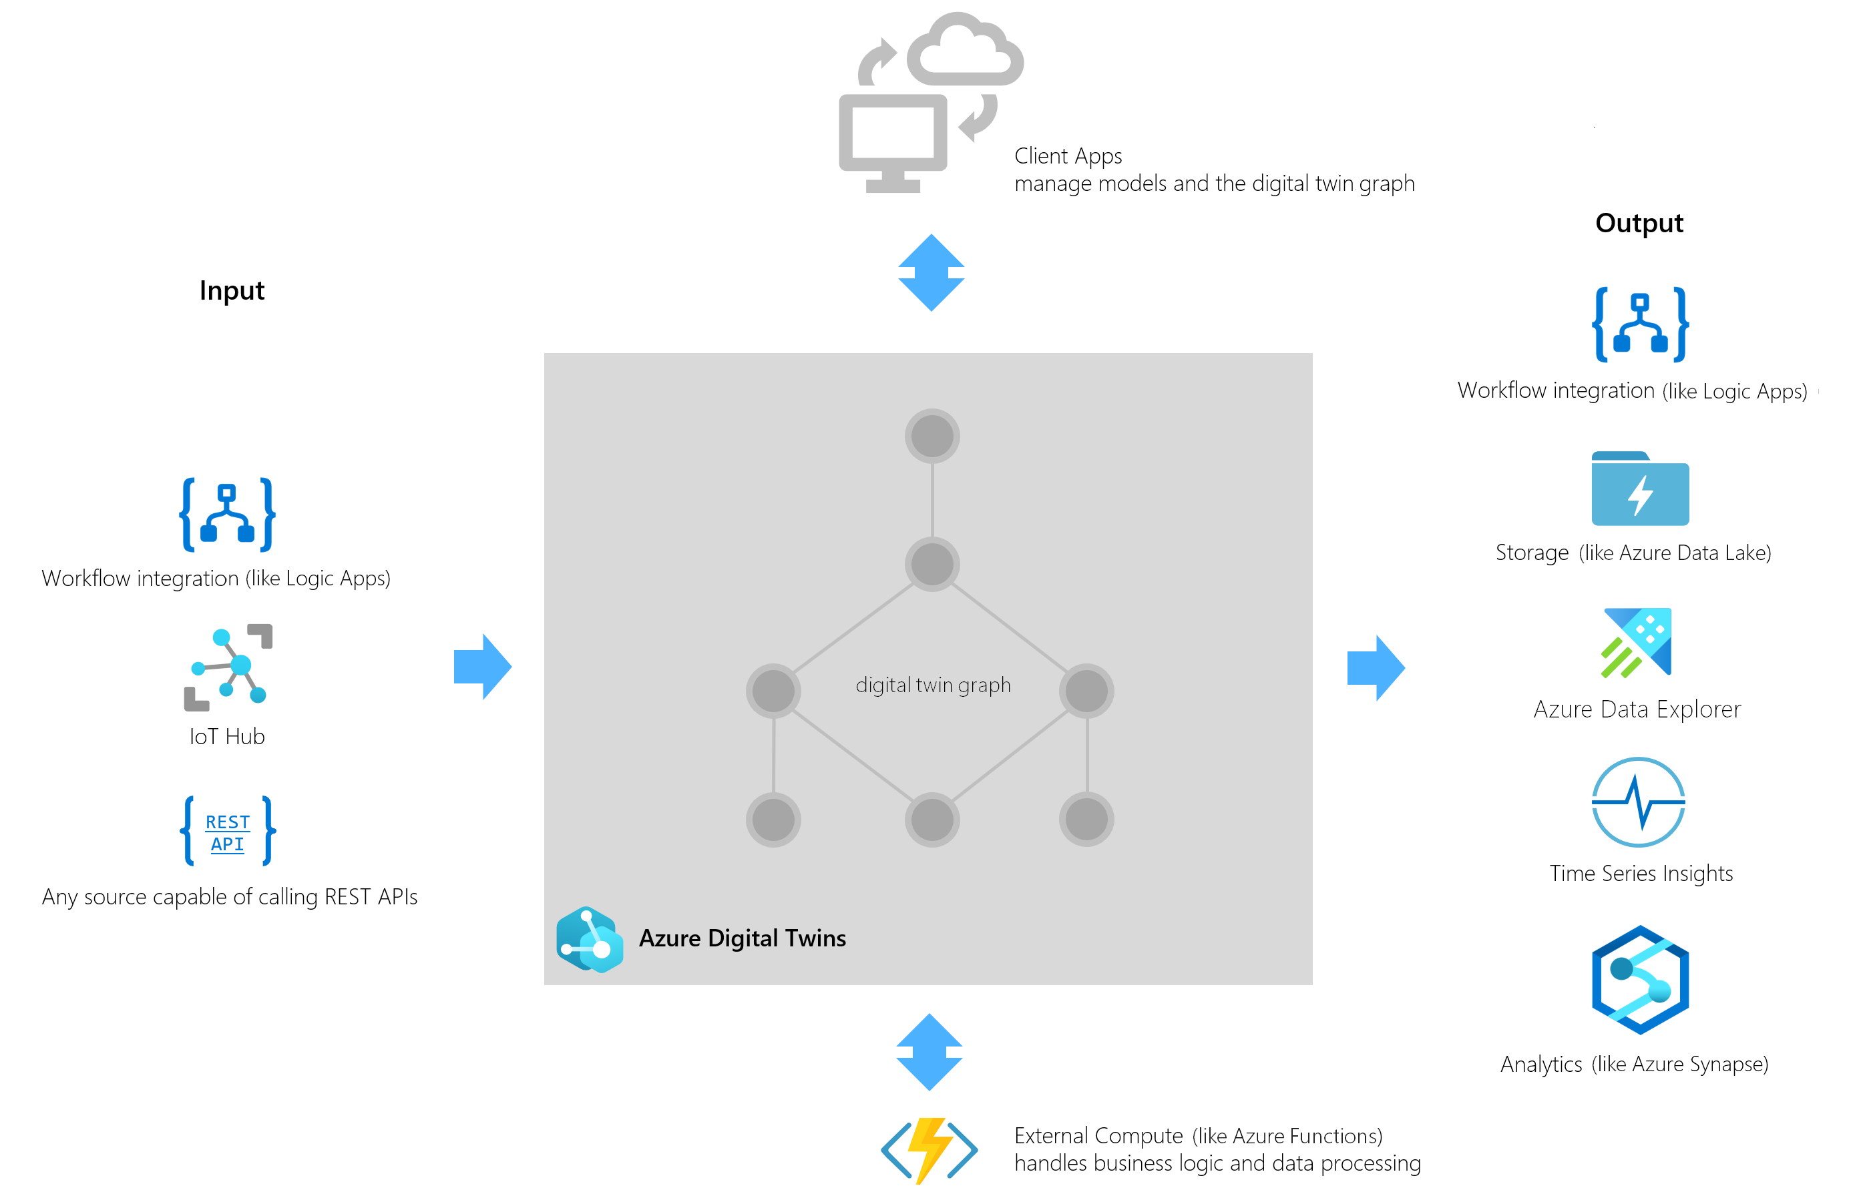

Slide 26

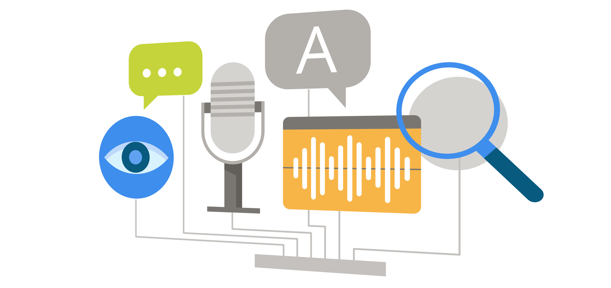

AI/ML for IoT with .NET

Slide 27
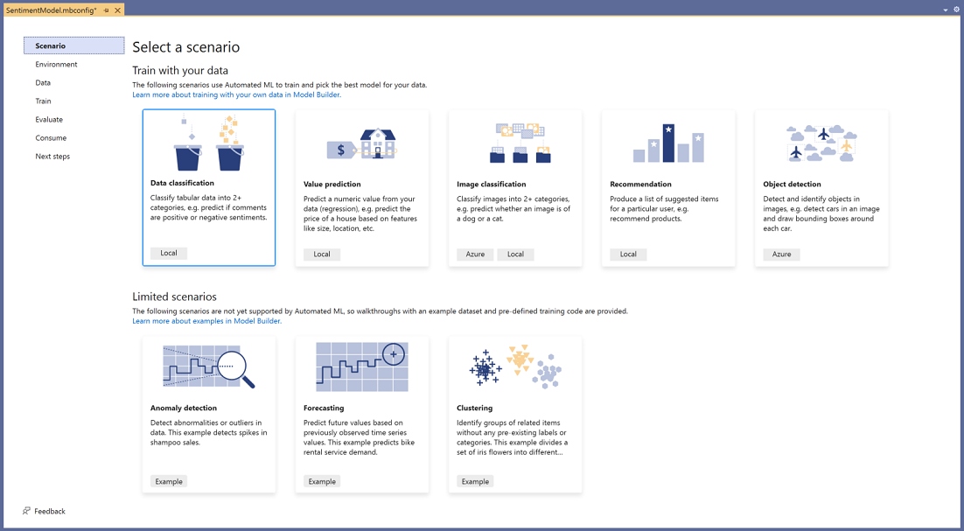

ML.NET

Slide 28
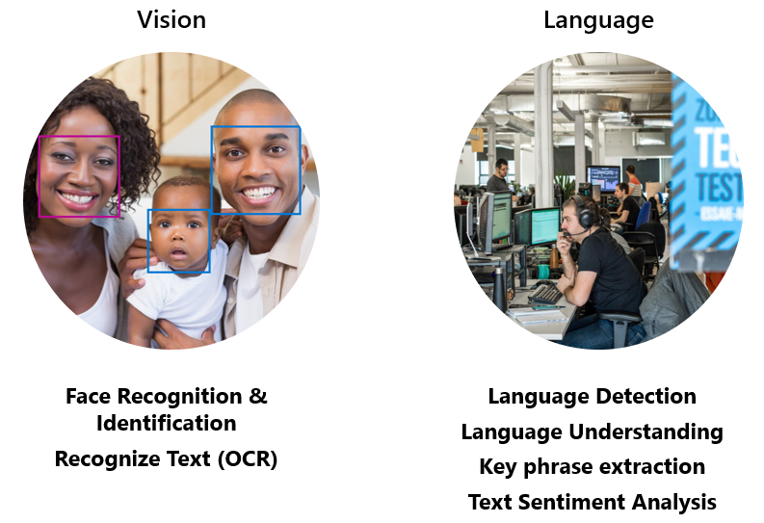
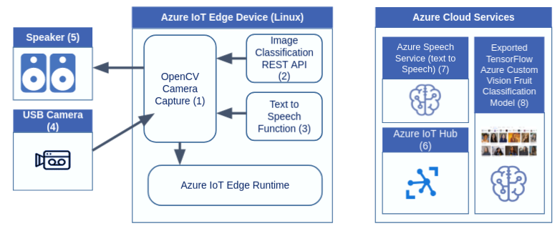
Azure Cognitive Services

Slide 29
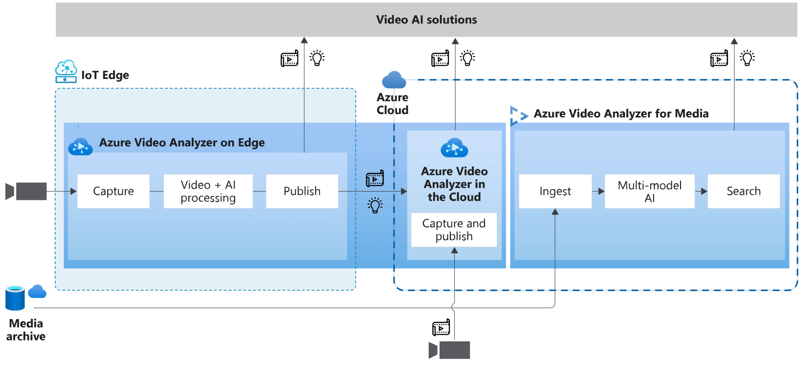
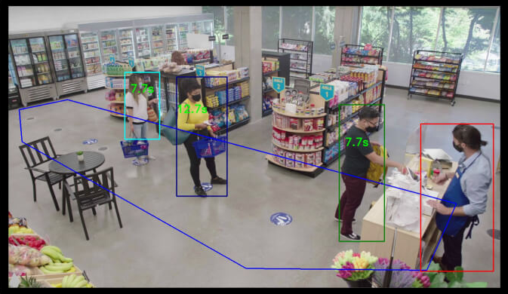
Azure Video Analyser

Slide 30
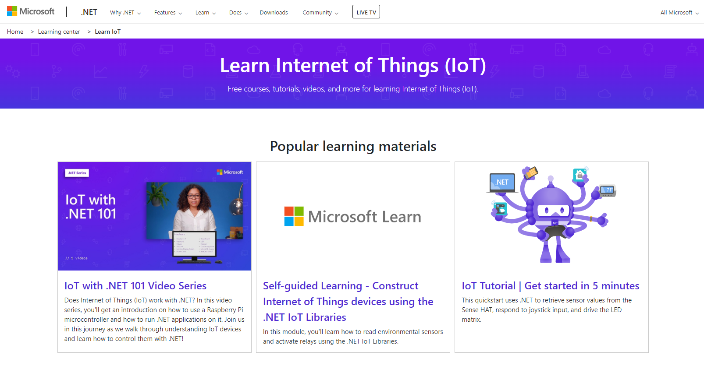

How to get started

Slide 31

Summary

Slide 32
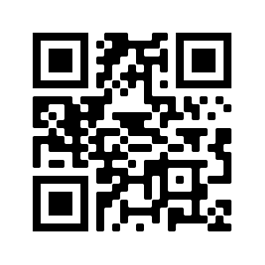
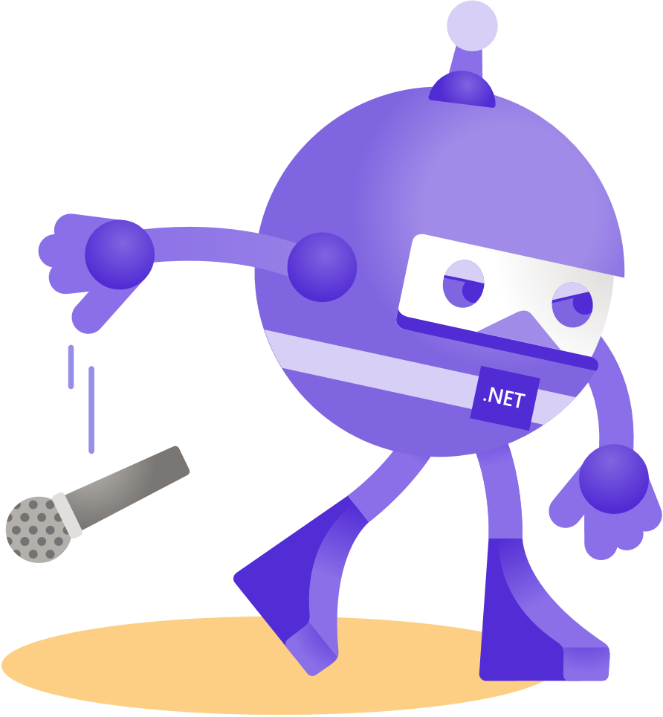

Thanks for joining!
https://bit.ly/dotnetconf-iot
melissahoughton.dev
melissahoughton
meliss_houghton
melissahoughton

